Slide 1

Employee Management System
Emmadi Srikar
Batch No :436
Innomatics Research
Labs Dilshuknagar

Slide 2
About me
I am Emmadi Srikar.
I completed my B.Tech in Computer Science and Engineering from St Mary’s Group of Institution Hyderabad.
LinkedIn : https://www.linkedin.com/in/emmadi-srikar-03baaa337
Github : https://github.com/srikar42

Slide 3
AGENDA :
Problem Statement
Objective
ER Diagram
Table and Fields
Queries
Key Insights
Conclusion

Slide 4
Problem Statement :
In a MNC Company, managing employee details like job roles, salary, leaves and payroll manually is difficult and it can cause errors.
This project creates an Employee Management systems that stores all employee information in one place and keeps connected.
Its helps HR easily update records, track leaves , and calculates salaries accurately, saving time and reducing the mistakes.

Slide 5
Objective :
To design and implement an SQL-based Employee Management System.
To maintain accurate and consistent employee data across multiple tables.
To track employee details, department information, qualifications, leaves, and payroll.
To enable analysis on salary, leave patterns, job roles, and departmental structure.
To provide a structured, relational database with foreign key constraints and cascading actions.

Slide 6
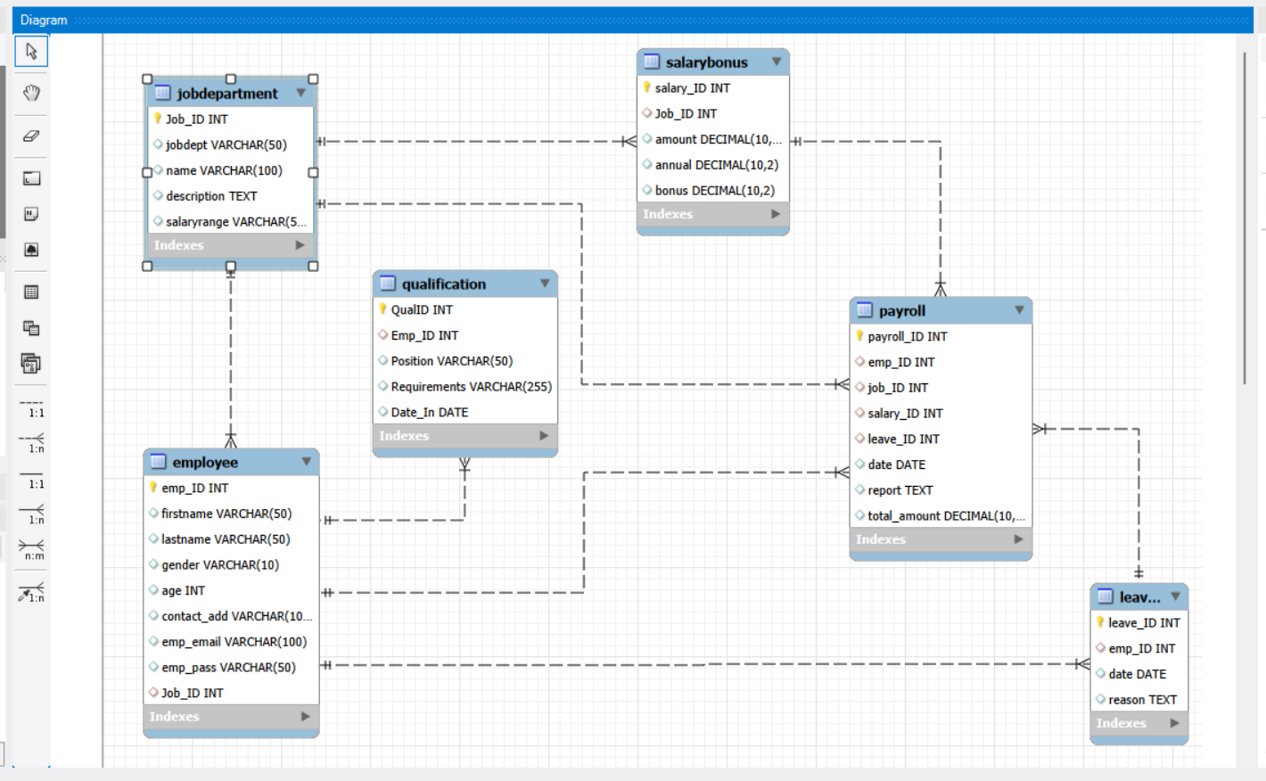
ER Diagram :

Slide 7
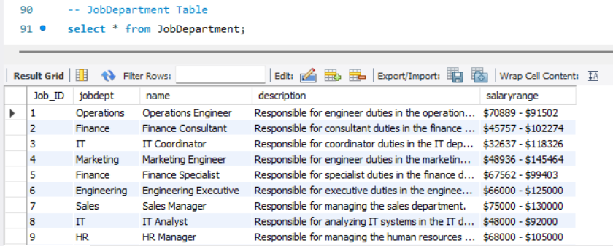
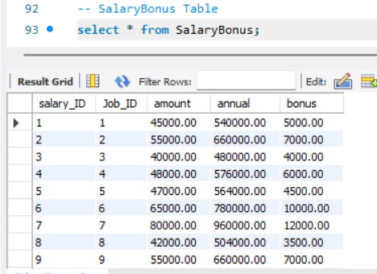
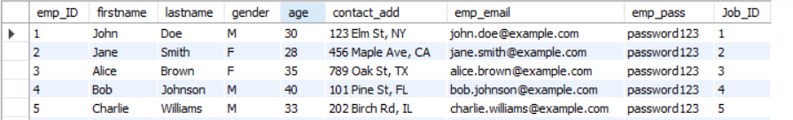
Job Department Table
Salary Bonus Table
Employee Table

Slide 8
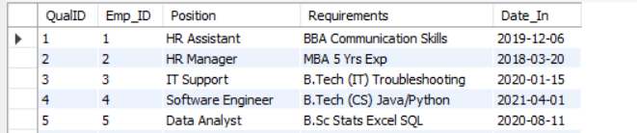
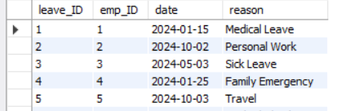
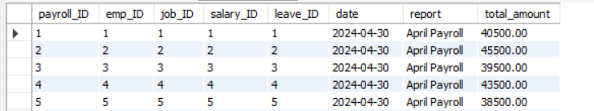
Qualification Table
Leaves Table
Payroll Table

Slide 9
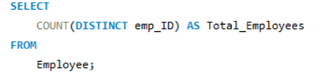

Queries :
How many unique employees are currently in the system?

Slide 10
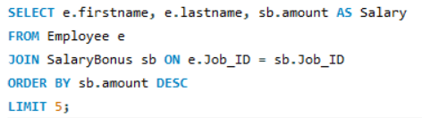
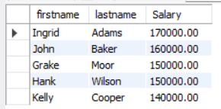
Who are the top 5 highest-paid employees?

Slide 11
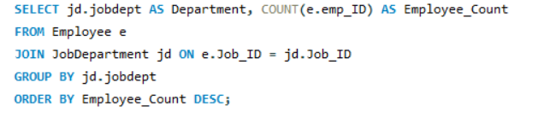
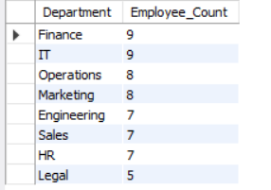
Which departments have the highest number of employees?

Slide 12
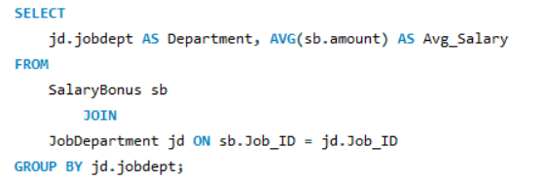
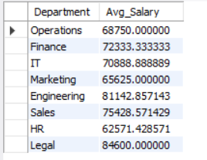
What is the average salary per department?

Slide 13
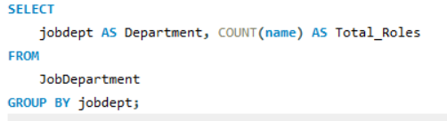
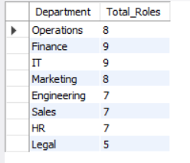
How many different job roles exist in each department?

Slide 14
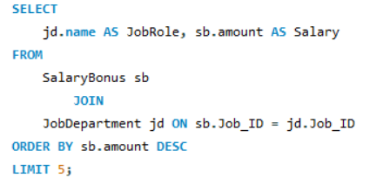
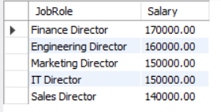
Which job roles offer the highest salary?

Slide 15
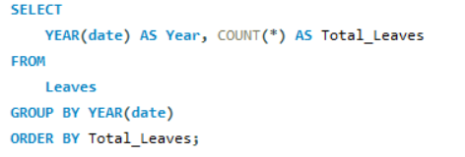

Which year had the most employees taking leaves?

Slide 16
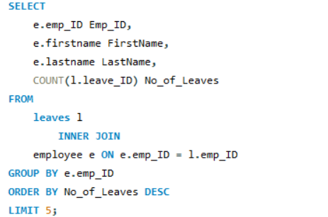
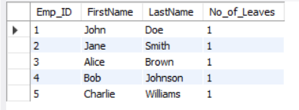
Which employees have taken the most leaves?

Slide 17
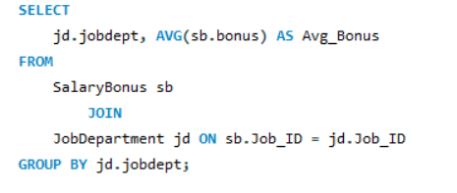
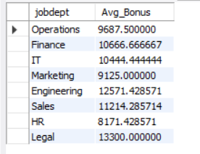
What is the average bonus given per department?

Slide 18
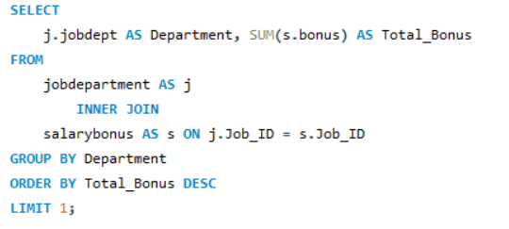

Which department receives the highest total bonuses?

Slide 19
Key Insights :
Total Employees: 60
Departments with highest employees: Finance & IT
Highest salary roles belong to Engineering & IT
Most leaves occurred in 2024
Average salary ranges were highest in Marketing and Legal
Payroll processing integrates salary, leaves, and job role data accurately

Slide 20
Conclusion :
The Employee Management System successfully integrates all employee-related information in a structured format.
The relational model maintains data integrity through foreign keys and cascading actions.
SQL queries provide meaningful insights into HR operations.
This project demonstrates strong understanding of database design,normalization, and SQL querying.

Slide 21


Slide 22

THANK YOU

